Slide 1
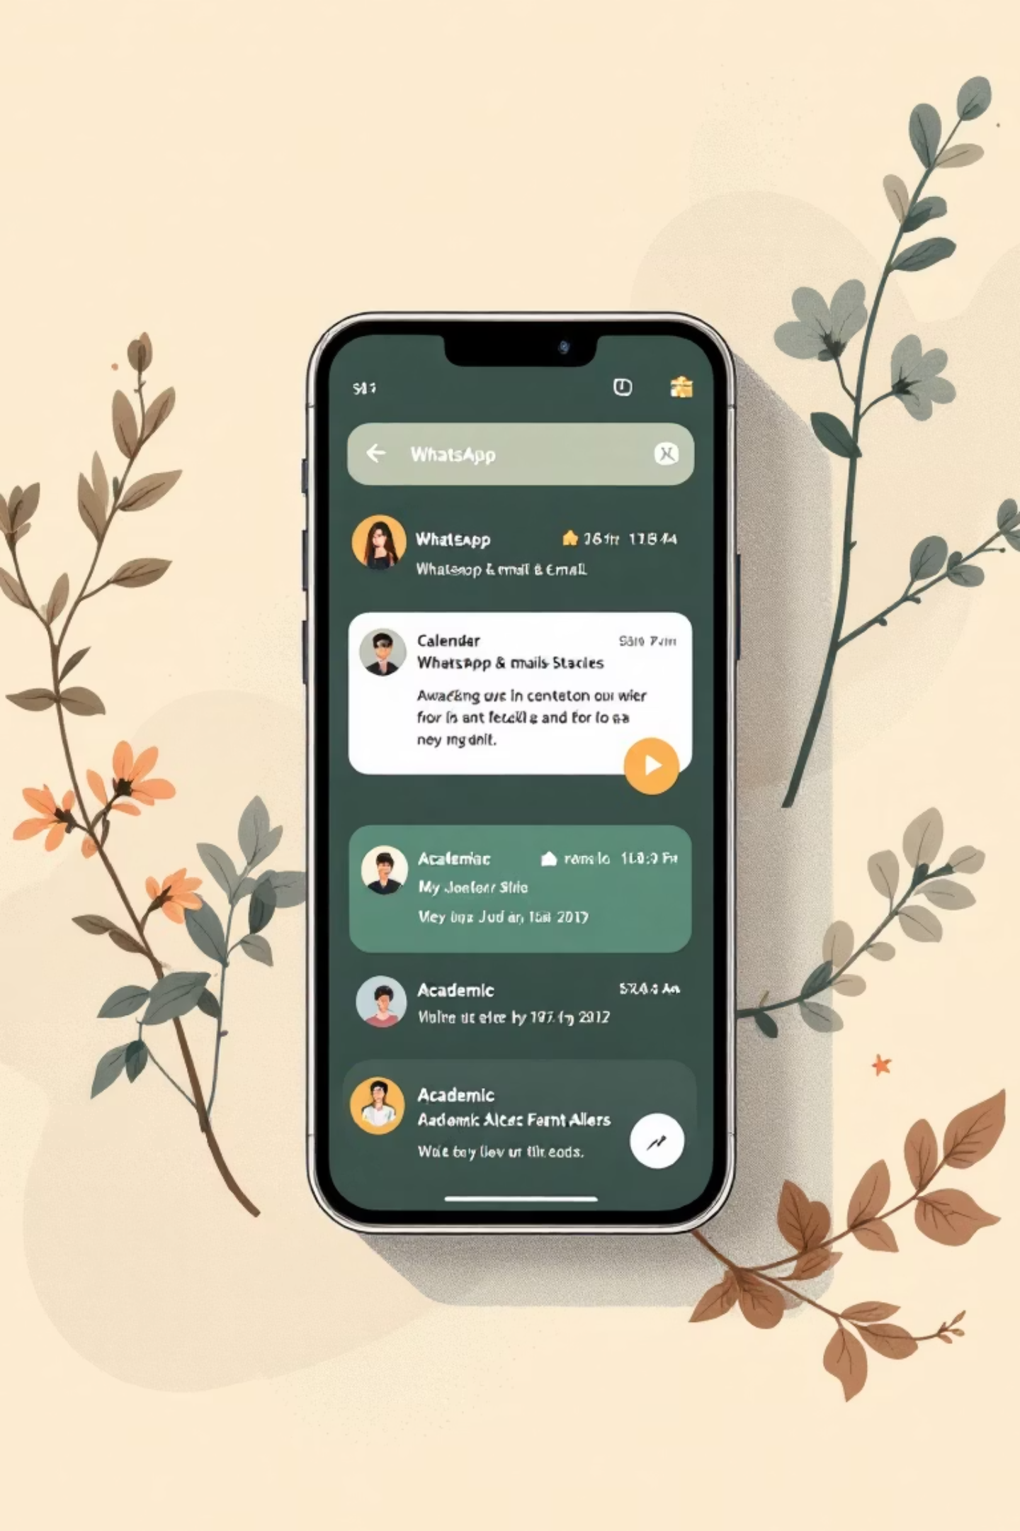
Automatic Classification of Academic Messages
ANNA ROSE THOMAS
2363010

Slide 2
Problem Statement
Students and faculty receive messages via WhatsApp, email, or academic portals:
College events
Tech talks and workshops
Assignments, deadlines, and notices
Sorting messages manually is time-consuming, and important events can be missed
Solution: Automatically classify messages into Event / Tech Talk / Other Academic
Optional: Trigger calendar reminders or notifications for Event/Tech Talk

Slide 3
Objectives
1
2
3
Classify academic messages into Event / Tech Talk / Other Academic
Preprocess text for NLP analysis
Train a Naive Bayes classifier
4
5
Automatically create reminders/notifications for Event/Tech Talk
Evaluate model performance on unseen messages

Slide 4







Methodology
Steps:
4. Model Training
3. Feature Extraction
Naive Bayes classifier
5. Prediction
2. Data Preprocessing
Bag-of-Words / TF–IDF
classify new messages
6. Automatic Reminder
lowercase, remove punctuation, tokenize
extract time/date → trigger alert
1. Dataset Creation
4
7. Evaluation
40–50 messages across 3 categories
3
5
accuracy, sample predictions
2
6
1
7

Slide 5
Dataset Creation
Why create manually?
Save Dataset: CSV with two columns:
Real WhatsApp/email messages may not be publicly available
Message
Label
Only 40–50 messages required for small project
"Join AI Tech Talk on 10th Sep at 3 PM"
Tech Talk
Manual creation ensures balanced categories
"Onam Celebration in College Auditorium tomorrow"
Event
Categories:
Event → College events, festivals, sports day, cultural events
"Assignment 2 submission deadline is tomorrow"
Other Academic
Tech Talk → Workshops, seminars, webinars
Other Academic → Assignments, deadlines, library notifications
Slightly vary messages to expand dataset; 40–50 messages is enough
Sample Messages:
Event: "Onam Celebration in College Auditorium tomorrow"
Tech Talk: "Join AI Tech Talk on 10th Sep at 3 PM"
Other Academic: "Assignment 2 submission deadline is tomorrow"

Slide 6
Preprocessing
Lowercasing
Remove Punctuation & Special Characters
Tokenization
Stopword Removal (Optional)
Converts all text to a uniform lowercase format.
Breaks down the cleaned text into individual words or "tokens."
Eliminates symbols, punctuation, and other non-alphanumeric characters.
Removes common, less informative words (e.g., "the", "is", "on") that add little semantic value.
"Onam Celebration Tomorrow" → "onam celebration tomorrow"
"join ai tech talk" → [join, ai, tech, talk]
"Submit assignment!!!🙂" → "submit assignment"
Stemming/Lemmatization (Optional)
Reduces words to their base or root form, improving consistency.
"submitting", "submitted" → "submit"
Cleaning this data is crucial as it significantly improves the accuracy and readability for NLP models like Naive Bayes.

Slide 7












Workflow Diagram
Incoming Academic Message
Preprocessing
Feature Extraction ( TF–IDF)
Naive Bayes Classifier
Category Prediction
Event / Tech Talk
Other Academic
→ Extract Time → Add Calendar Reminder / Trigger Notification
→ Display Only

Slide 8
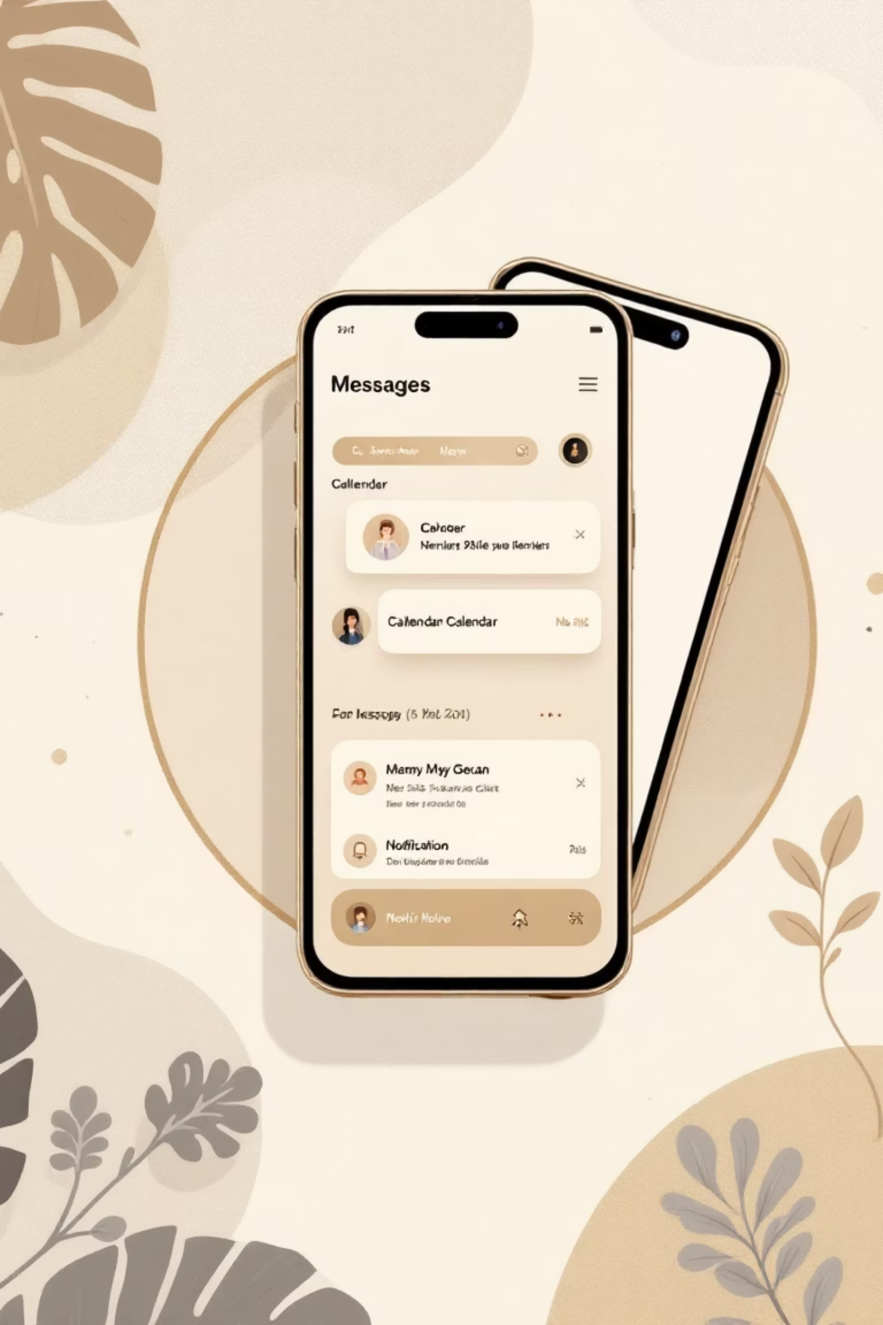




Key Features & Benefits
Automatic classification
of academic messages
Reminders for important events
→ better time management
Small dataset
→ easy to implement
Practical real-life application
→ unique project

Slide 9
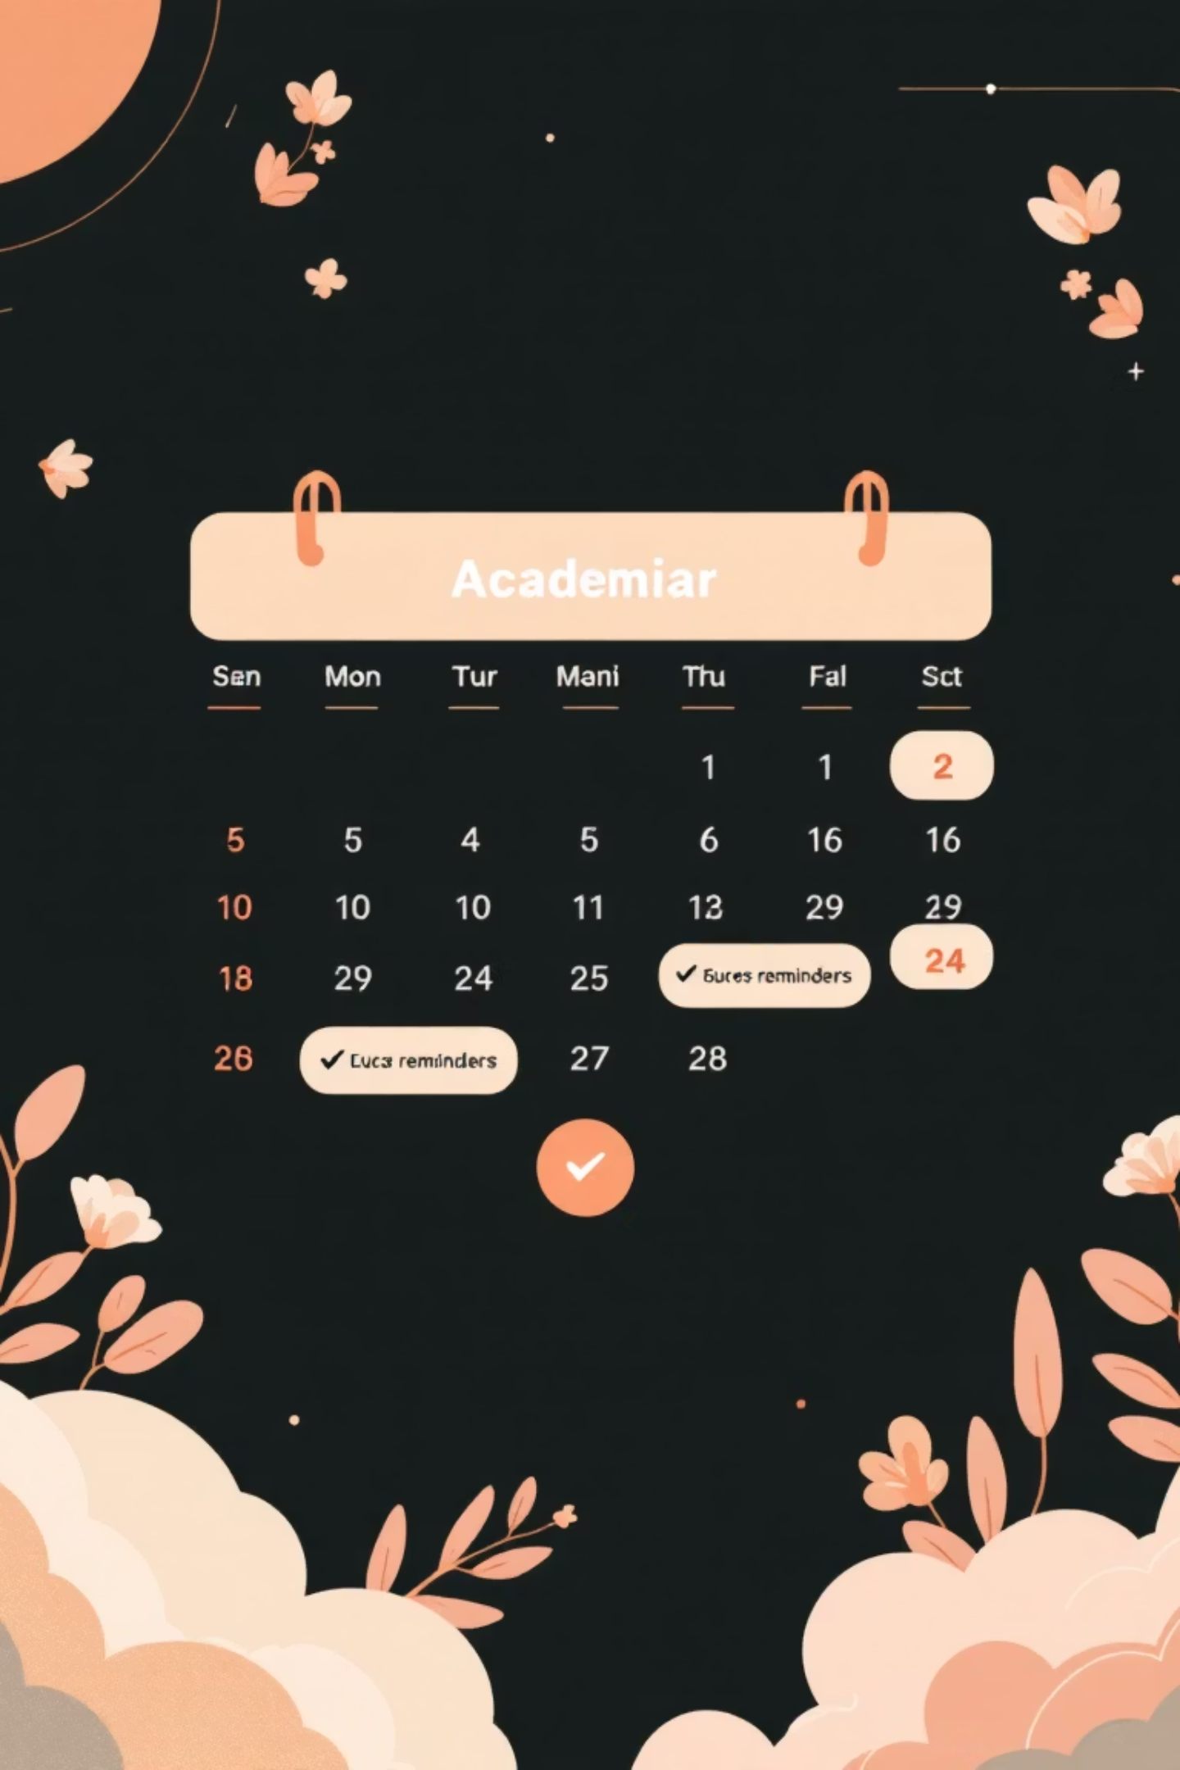
Conclusion & Future Scope
Students/faculty can stay organized and never miss important events
Future scope:
Integration with Gmail/WhatsApp
Mobile notifications
Real-time classification

